Slide 1
CSC 735 – Data Analytics
Chapter 7
Aggregations

Slide 2
Aggregations
Aggregation is considered a corner stone for big data analytics
It allow us to summarize the data in order to extract patterns or insights
Ex: sum, average, stdev, count

Slide 3
Aggregations (cont.)
Spark has many functions for aggregations
For big data analysis, it can be expensive to get an exact answer
There are many aggregate functions that provide an answer with a reasonable degree of accuracy
The aggregation functions are designed to perform aggregation on a set of rows in a DataFrame
The set of rows can be all or some of the rows

Slide 4
Reading the Dataset
val df = spark.read.format("csv")
.option("header", "true")
.option("inferSchema", "true")
.load("/data/retail-data/all/*.csv")
.coalesce(5)
df.cache()
df.createOrReplaceTempView("dfTable")

Slide 5
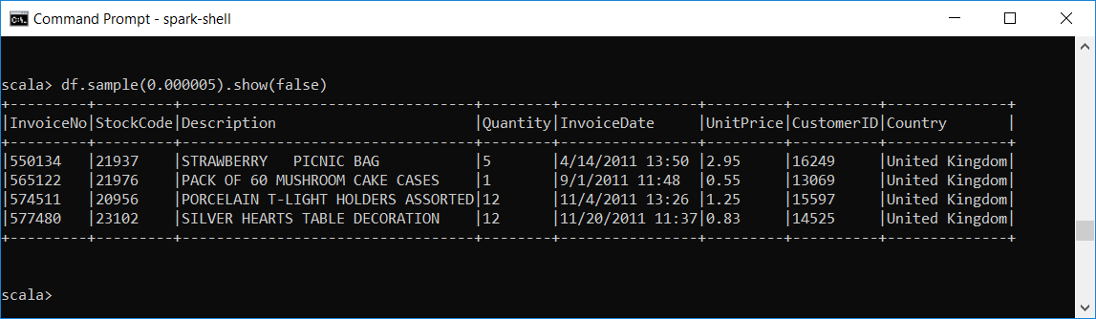
A Sample of the Data

Slide 6
Aggregate Functions
All aggregations are available as functions
Most aggregation functions are in the package org.apache.spark.sql.functions

Slide 7
count
Use to count
In this example, count performs as a transformation instead of an action
Using count, we can do one of 2 things:
specify a certain column to count
or count all the columns by using count("*")
aggregate functions ignore null values; count(*) does not
import org.apache.spark.sql.functions.count
df.select(count("StockCode")).show() // 541909

Slide 8
countDistinct
It counts only the unique values under a given column
import org.apache.spark.sql.functions.countDistinct
df.select(countDistinct("StockCode")).show() // 4070

Slide 9
approx_count_distinct
Counting the exact number of unique items in each group in a large dataset can take long time
Sometimes, it is sufficient to have an approximation to a certain degree of accuracy
In such case, we can use approx_count_distinct
import org.apache.spark.sql.functions.approx_count_distinct
df.select(approx_count_distinct("StockCode", 0.05)).show() // 3804
df.select(countDistinct("StockCode")).show() // 4070

Slide 10
first and last
Give the first and last values from a DataFrame
import org.apache.spark.sql.functions.{first, last}
df.select(first("StockCode"), last("StockCode")).show()

Slide 11
min and max
Do as their names suggest
Domain does not have to be numeric
import org.apache.spark.sql.functions.{min, max}
df.select(min("Quantity"), max("Quantity")).show()

Slide 12
sum
Gives the sum of all the values in a column
import org.apache.spark.sql.functions.sum
df.select(sum("Quantity")).show() // 5176450
+----------------+
|sum(Quantity)|
+-----------------+
| 5176450 |
+-----------------+

Slide 13
sumDistinct
It sums up the distinct values of a numeric column
import org.apache.spark.sql.functions.sumDistinct
df.select(sumDistinct("Quantity")).show() // 29310
df.select(sum("Quantity")).show() // 5176450

Slide 14
avg
calculates the average value of a numeric column
divides the sum by the number of values
This example validates that
import org.apache.spark.sql.functions.{sum, count, avg, expr}
df.select(
count("Quantity").alias("total_transactions"),
sum("Quantity").alias("total_purchases"),
avg("Quantity").alias("avg_purchases"),
expr("mean(Quantity)").alias("mean_purchases"))
.selectExpr(
"total_purchases/total_transactions",
"avg_purchases",
"mean_purchases").show()

Slide 15
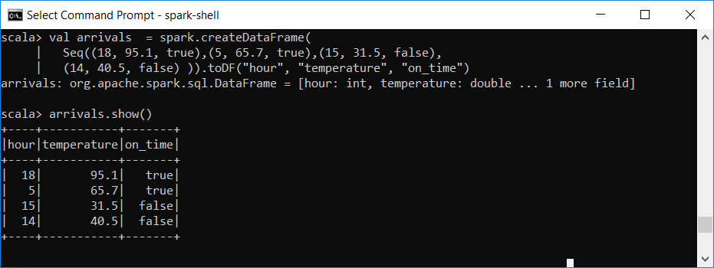
The expr Function
It allows us to refer to a column in a DF and evaluate an expression on each value in the column

Slide 16
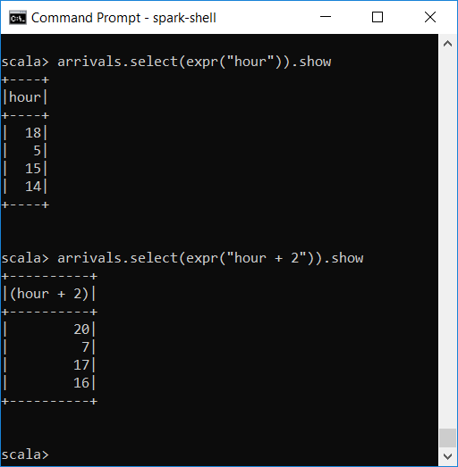
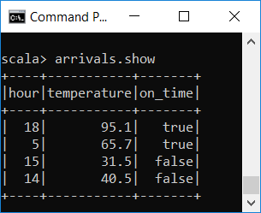
The expr Function (cont.)

Slide 17
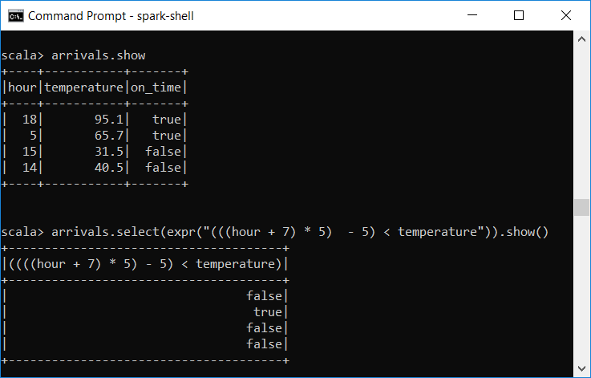
The expr Function (cont.)

Slide 18
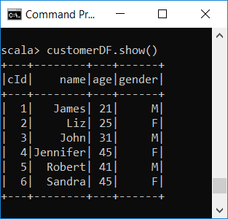
select
It returns a DataFrame containing the specified columns
case class Customer(cId: Long, name: String, age: Int, gender: String)
val customerDF = Seq(Customer(1, "James", 21, "M"),
Customer(2, "Liz", 25, "F"),
Customer(3, "John", 31, "M"),
Customer(4, "Jennifer", 45, "F"),
Customer(5, "Robert", 41, "M"),
Customer(6, "Sandra", 45, "F")).toDF

Slide 19
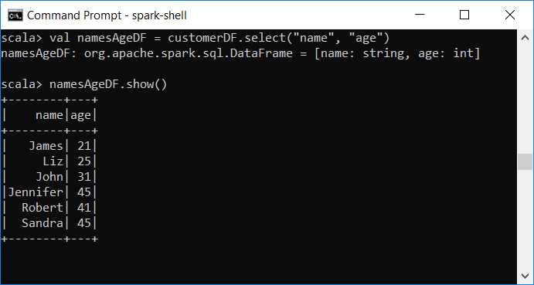
select (cont.)

Slide 20
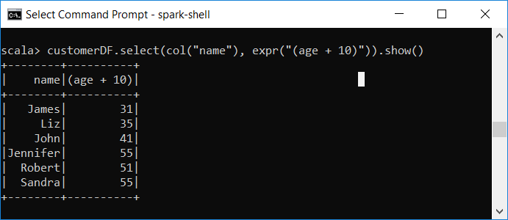
select (cont.)
During the selection, each column can be transformed via a column expression
customerDF.select($"name", expr("(age + 10)")).show()

Slide 21
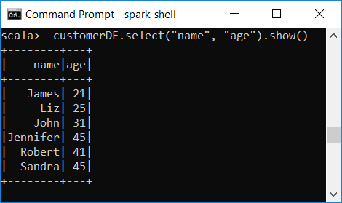
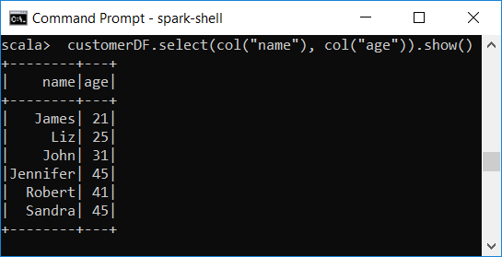
select (cont.)
A common error is to mix column objects and strings
The following code results in a compiler error
customerDF.select("name", col("age")).show()

Slide 22
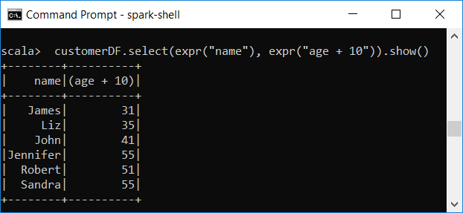
selectExpr
The expr function is very flexible
It allows us refer to refer to a column or apply an expression to a column
Since select followed by a series of expr is a common pattern, Spark has a shorthand for doing so: selectExpr
customerDF.select(expr("name"), expr("age + 10")).show()

Slide 23
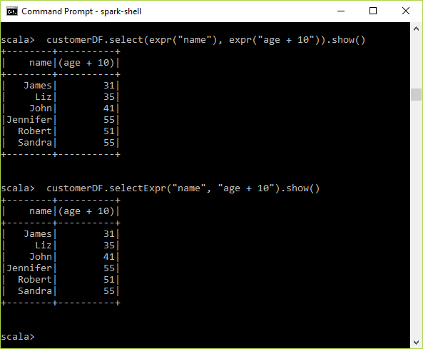
selectExpr
These are equivalent
customerDF.select(expr("name"), expr("age + 10")).show()
customerDF.selectExpr("name", "age + 10").show()

Slide 24
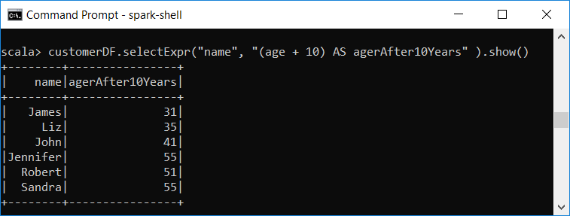
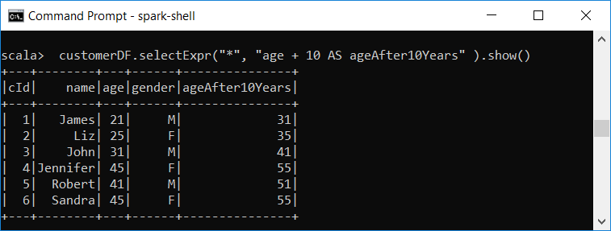
selectExpr

Slide 25
selectExpr
We can use aggregate functions with selectExpr
customerDF.selectExpr("avg(age)", "count(name)").show() +-------------------------+--------------+
| avg(age)|count(name)|
+-------------------------+--------------+
|34.666666666666664| 6|
+-------------------------+--------------+

Slide 26
Variance and Standard Deviation
They are measures of the spread of the data around the mean
average distance of the values from the mean
low variance indicates the values are close to the mean
standard deviation is the square root of the variance

Slide 27
Variance and Standard Deviation
The functions var_pop(col), stddev_pop(col) do the calculations using the whole population
The functions var_samp(col), stddev_samp(col) do the calculations using a sample of the population
By default, the functions variance(col) and stddev(col) use a sample

Slide 28
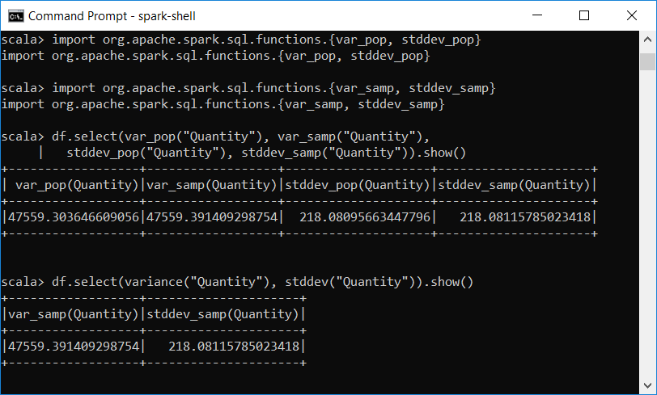
Variance and Standard Deviation

Slide 29
The agg Method
DF method agg allows us to perform multiple aggregations per group at the same time

Slide 30
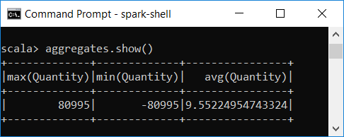
The agg Method - Examples
val aggregates = df.agg(max("Quantity"), min("Quantity"), avg("Quantity"))
//aggregates: org.apache.spark.sql.DataFrame = [max(Quantity): int, min(Quantity): int ... 1 more field]

Slide 31
Aggregating to Complex Types
collect_list(col) allows us to collect a list of the values present in a given column
collect_set(col) allows us to collect a set of the unique values in a given column

Slide 32
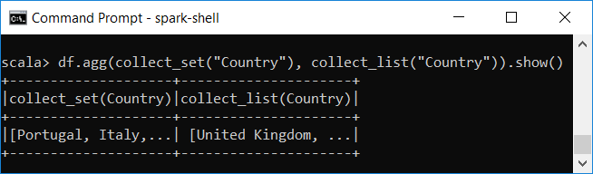
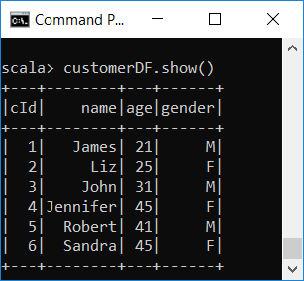
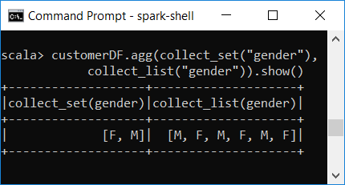
Aggregating to Complex Types - Example

Slide 33
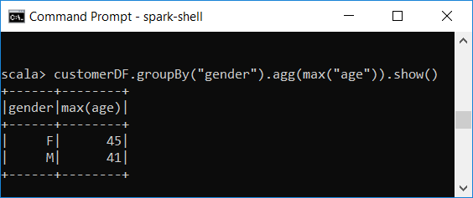
Grouping
The function groupBy is used to form groups over one or more categorical attributes
Then we use aggregate functions to perform aggregations on each of the subgroups inside the DataFrame

Slide 34
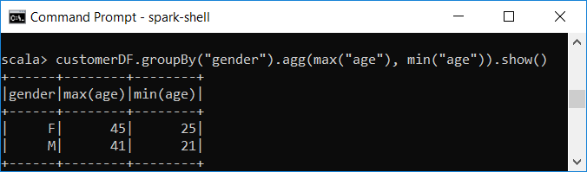
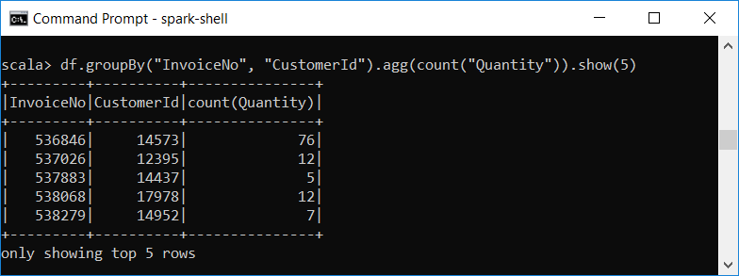
More examples

Slide 35
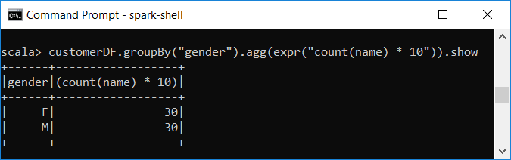
Grouping with Expressions
Parameters of agg can involve expressions

Slide 36
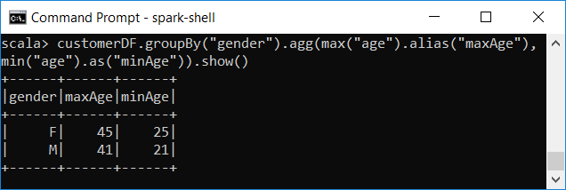
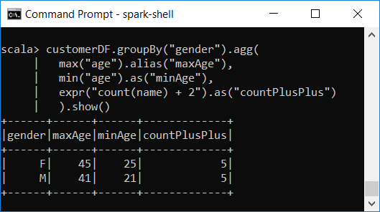
Grouping with Expressions – Renaming Columns
We can rename inside agg using .alias and .as

Slide 37
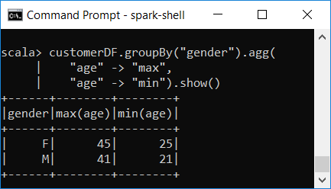
Grouping with Maps
We can specify the arguments of the agg function as a series of key-value maps
the key is the column name, and
the value is an aggregation function to apply to the key

Slide 38
Grouping Sets
Grouping sets allow for more complex grouping operations
They allow us to do an aggregation across multiple groups
The results from the different groups are combined in the same output
So, aggregate functions are computed for each group, and then the results are added to the output

Slide 39
Grouping Sets (cont.)
Each sublist of grouping sets may specify zero or more columns
An empty grouping set means that all rows are aggregated down to a single group
References to the grouping columns are replaced by null values in result rows

Slide 40
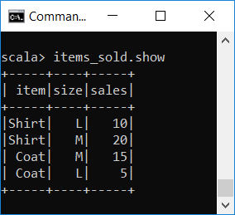
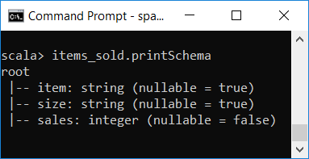
Grouping Sets – Examples
val items_sold = Seq( ("Shirt", "L", 10), ("Shirt", "M", 20),
("Coat", "M", 15), ("Coat", "L", 5)
).toDF("item", "size", "sales")
items_sold.createOrReplaceTempView("items_sold_Table")

Slide 41
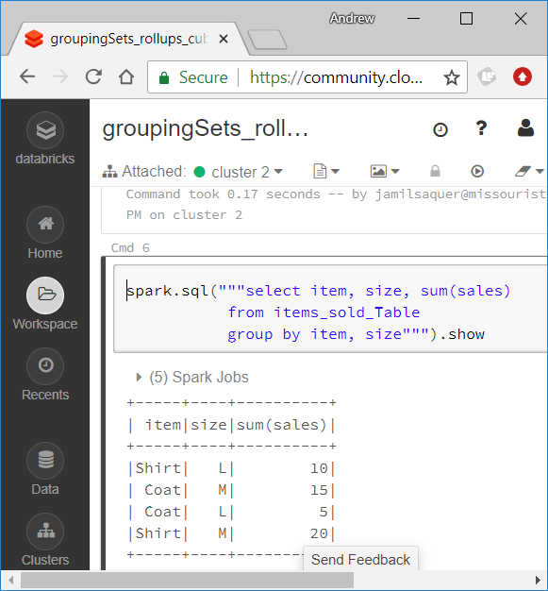
Grouping Sets – Examples

Slide 42
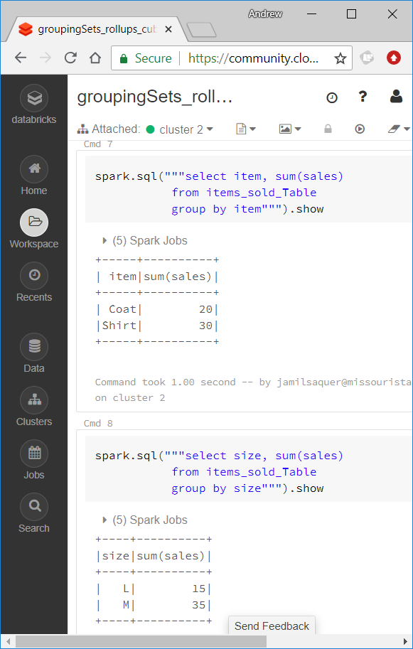
Grouping Sets – Examples

Slide 43
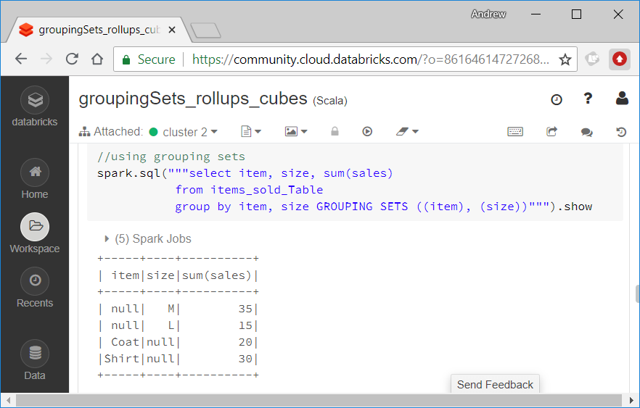
Grouping Sets – Examples

Slide 44
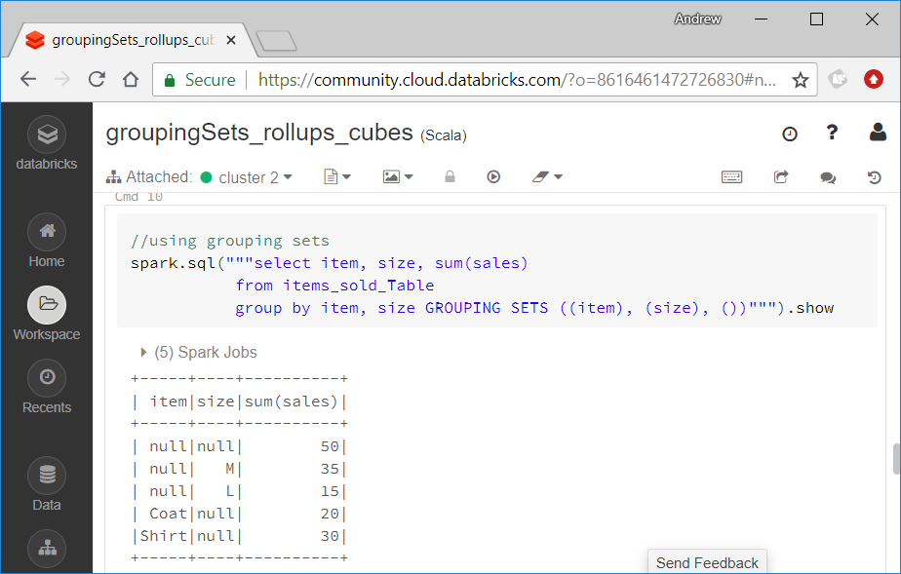
Grouping Sets – Examples

Slide 45
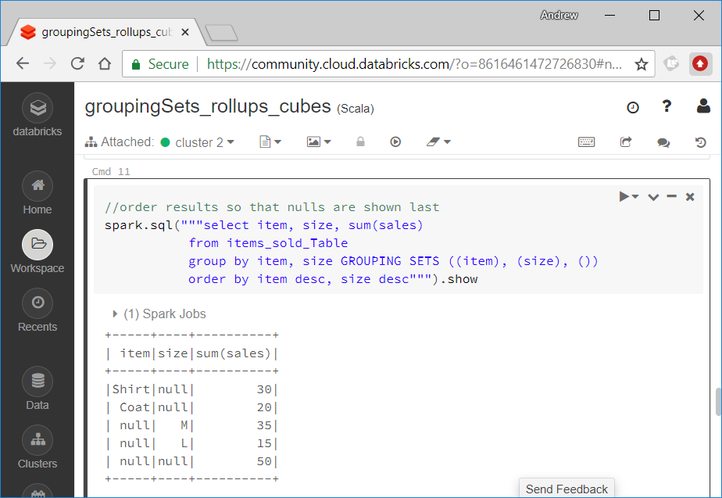
Grouping Sets – Examples

Slide 46
Aggregations with Rollups and Cubes
Grouping sets are only available in SQL
To do the same thing using DataFrames, we use rollup and cube operations

Slide 47
Grouping Sets – Rollups
A clause of the form is equivalent to a GROUPING SET operation that represents the given list of expressions and all prefixes of the list including the empty list
It is equivalent to
ROLLUP ( e1, e2, e3, ... )
GROUPING SETS (
( e1, e2, e3, ... ),
...
( e1, e2 ),
( e1 ),
( )
)

Slide 48
Rollups
Rollups are useful for data analysis over hierarchical data
total salary by department, division, and company-wide total
revenue data over different departments, divisions, and the grand total

Slide 49
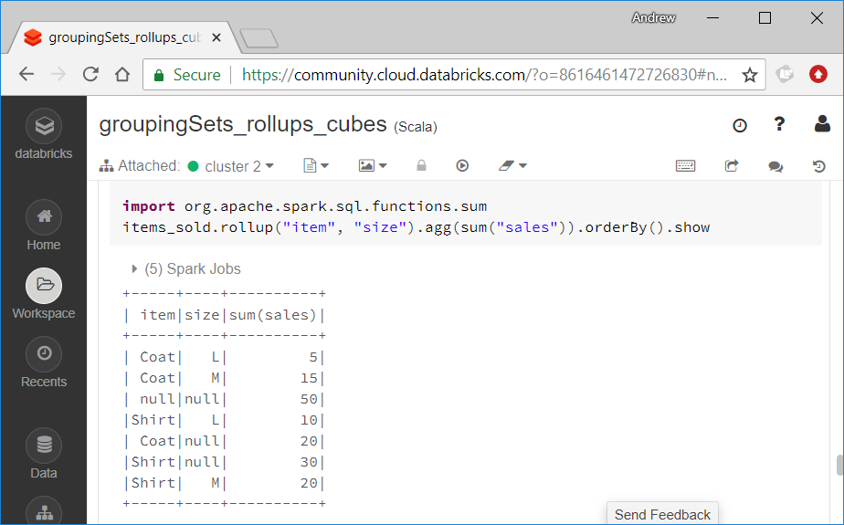
Rollups – Example

Slide 50
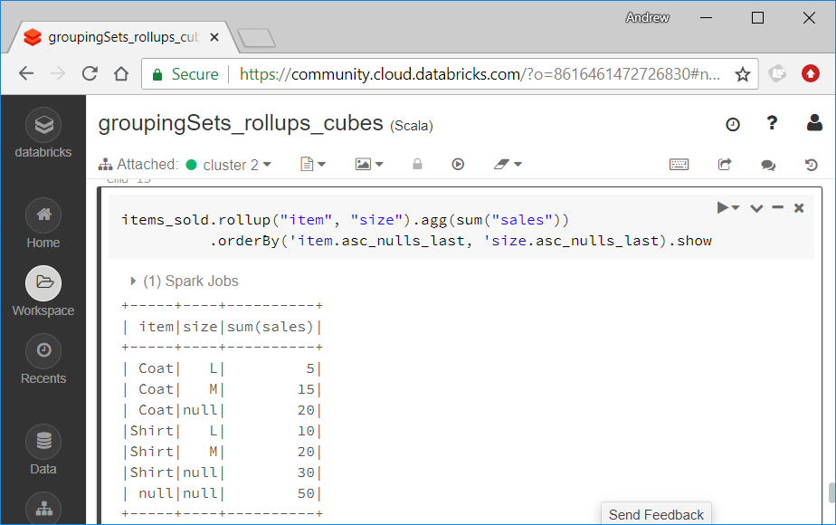
Rollups – Example
We can use asc_nulls_first, desc_nulls_first, asc_nulls_last, or desc_nulls_last to specify where we would like null values to appear

Slide 51
Grouping Sets – Cubes
A clause of the form is equivalent to
CUBE ( e1, e2, e3, ... )
GROUPING SETS (
( a, b, c ),
( a, b ),
( a, c ),
( a ),
( b, c ),
( b ),
( c ),
( )
)

Slide 52
Cubes
A cube is a more advanced version of a rollup
It performs the aggregations across all the possible combinations of the grouping columns
Therefore, the result includes what a rollup provides as well as other combinations.

Slide 53
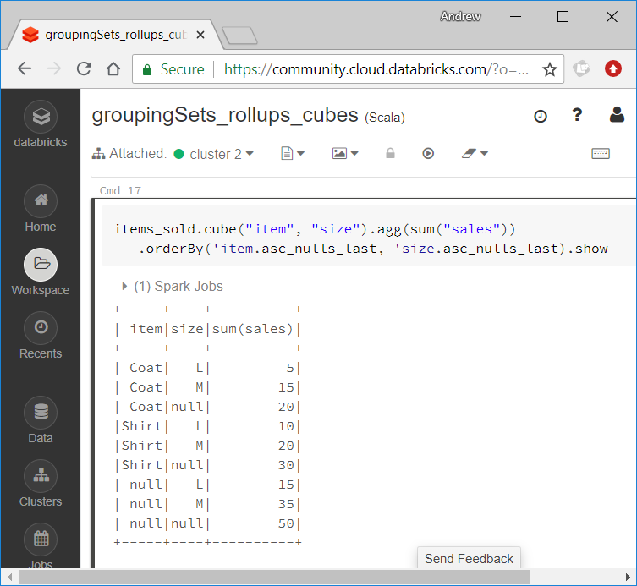
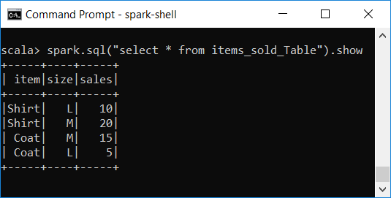
Cubes – Example

Slide 54
Pivot
Pivoting is a technique to convert rows into columns
This allows us to create a different view of a table
Pivoting starts with grouping over one or more columns, then pivoting on a column, and ends with applying one or more aggregations on one or more columns

Slide 55
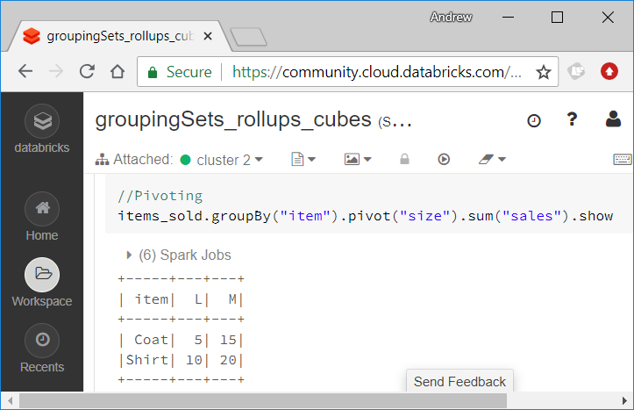
Pivot - Example

Slide 56
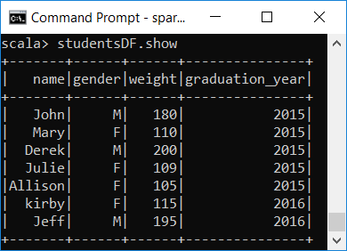
Pivot - Example
case class Student(name:String, gender:String, weight:Int, graduation_year:Int)
val studentsDF = Seq(Student("John", "M", 180, 2015),
Student("Mary", "F", 110, 2015),
Student("Derek", "M", 200, 2015),
Student("Julie", "F", 109, 2015),
Student("Allison", "F", 105, 2015),
Student("kirby", "F", 115, 2016),
Student("Jeff", "M", 195, 2016)).toDF

Slide 57
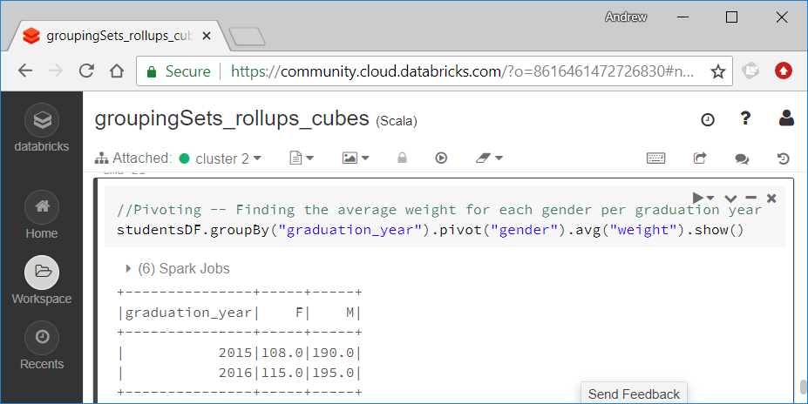
Pivot - Example

